Slide 1
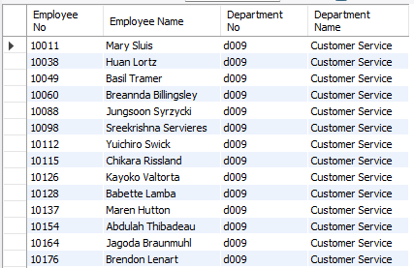
1. List of Employees by Department Question: Write a query to list all employees along with their respective department names. Include employee number, first name, last name, department number, and department name.
Query
select e.emp_no as 'Employee No',concat(e.first_name ,' ', e.last_name) as 'Employee Name',de.dept_no as 'Department No', d.dept_name as 'Department Name' from employees as e join dept_emp as de on e.emp_no = de.emp_no join departments as d on de.dept_no = d.dept_no;
Output

Slide 2
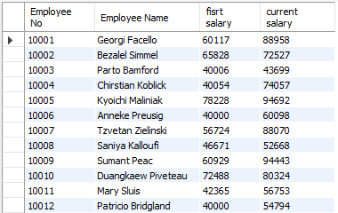
2. Current and Past Salaries of an Employee Question: Write a query to retrieve all the salary records of a given employee (by employee number). Include employee number, employee name, first salary and current salary.
Query
SELECT e.emp_no AS 'Employee No', CONCAT(e.first_name, ' ', e.last_name) AS 'Employee Name', MIN(s.salary) AS 'fisrt salary', MAX(s.salary) AS 'current salary'FROM employees AS e JOIN salaries AS s ON e.emp_no = s.emp_noGROUP BY e.emp_no;
Output

Slide 3
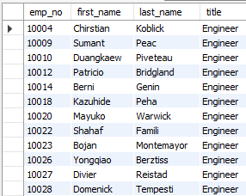
3. Employees with Specific Titles Question: Write a query to find all employees who have held a specific title (e.g., ‘Engineer’). Include employee number, first name, last name, and title.
Query
SELECT e.emp_no, e.first_name, e.last_name, t.title FROM employees AS e JOIN titles AS t ON e.emp_no = t.emp_nowhere t.title = 'Engineer'limit 100;
Output

Slide 4
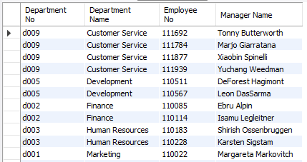
4. Departments with Their Managers Question: Write a query to list all departments along with their current managers. Include department number, department name, manager’s employee number, first name, and last name.
Query
select d.dept_no as 'Department No',d.dept_name as 'Department Name',e.emp_no as 'Employee No',concat(e.first_name,' ',e.last_name) as 'Manager Name' from departments as djoin dept_manager as dm on d.dept_no = dm.dept_no join employees as e on dm.emp_no=e.emp_no;
Output

Slide 5
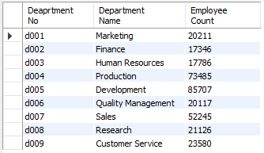
5. Employee Count by Department Question: Write a query to count the number of employees in each department. Include department number, department name, and employee count.
Query
select d.dept_no as 'Deaprtment No',d.dept_name as 'Department Name',count(de.emp_no) as 'Employee Count'from departments as d join dept_emp as de on d.dept_no=de.dept_nogroup by dept_name order by d.dept_no;
Output

Slide 6
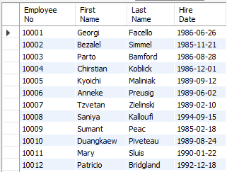
7. Employees Hired in the Last 5 Years Question: Write a query to find all employees hired in the last 5 years. Include employee number, first name, last name, and hire date.
Query
select emp_no as 'Employee No',first_name as 'First Name',last_name as 'Last Name',hire_date as 'Hire Date' from employeeswhere hire_date >= date_sub(curdate(), interval 50 year);
Output

Slide 7
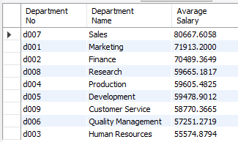
8. Average Salary by Department Question: Write a query to calculate the average salary for each department. Include department number, department name, and average salary.
Query
select d.dept_no as 'Department No',d.dept_name as 'Department Name',avg(salary) as 'Avarage Salary' from departments as d join dept_emp as de on d.dept_no=de.dept_no join salaries as s on de.emp_no=s.emp_nogroup by d.dept_name order by avg(salary) desc;
Output

Slide 8
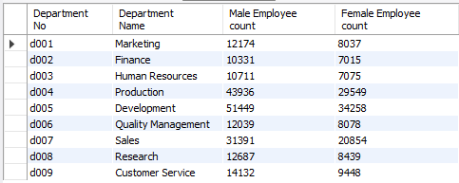
9. Gender Distribution in Each Department Question: Write a query to find the gender distribution (number of males and females) in each department. Include department number, department name, count of males, and count of females.
Query
select d.dept_no as 'Department No',d.dept_name as 'Department Name',SUM(CASE WHEN e.gender = 'M' THEN 1 ELSE 0 END) AS 'Male Employee count',SUM(CASE WHEN e.gender = 'F' THEN 1 ELSE 0 END) AS 'Female Employee count'from departments as d join dept_emp as de on d.dept_no=de.dept_no join employees as e on de.emp_no=e.emp_no group by d.dept_name order by d.dept_no asc;
Output

Slide 9
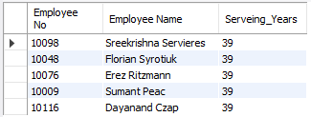
10. Longest Serving Employees Question: Write a query to find the employees who have served the longest in the company. Include employee number, first name, last name, and number of years served.
Query
select emp_no as 'Employee No',concat(first_name,' ',last_name) as 'Employee Name', timestampdiff(year,hire_date, CURDATE()) as 'Serveing_Years'from employees order by Serveing_Years desclimit 5;
Output

